Slide 1

Windows PowerShell
System administration and automation in a Windows environment
-File system -
Karin De Maertelaere, Jochen Mariën

Slide 2
The file system
We’ve had navigation in the file system earlier
This presentation is about the security of files and folders
This isn’t easy, even with the GUI
And the lack of ‘simple’ cmdlets doesn’t help

Slide 3
The file system
Contents
Disks
Reading files

Slide 4
Odd enough to repeat
Get-ChildItem -Path C:\tmp\*.txt -recurse
Fine in version 3.0 and later
Wrong in version 2.0 and earlier
Always correct:
Get-ChildItem -Path C:\tmp\ -filter *.txt -recurse

Slide 5
Disks
Most computers have at least one disk
We can query these in four ways
Get-Disk
Get-PSDrive
[System.IO.DriveInfo]::GetDrives()
Get-CimInstance Win32_LogicalDisk
These will all provide information on the same drives
The details they offer differ
The name of the properties also differ

Slide 6
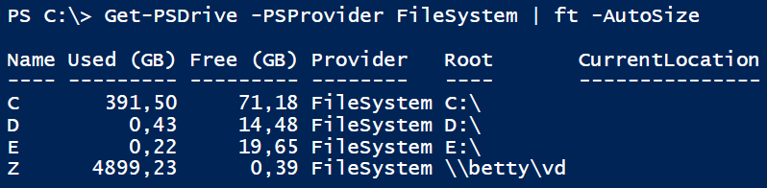
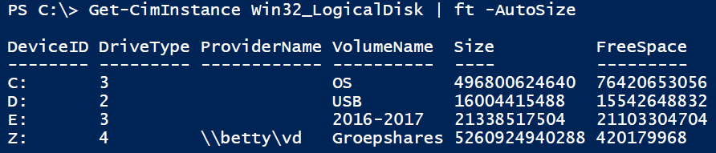
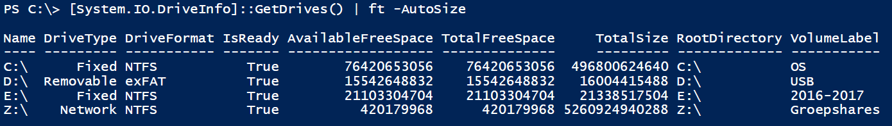
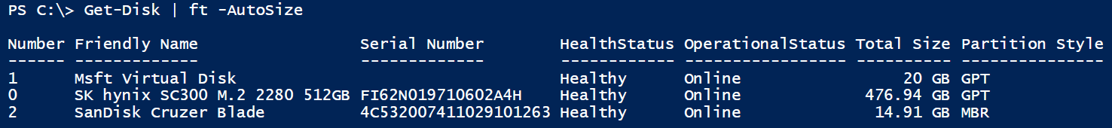
Disks
On a computer with 4 drives
Normal hard drive
USB-key
Attached VHDX-file
Attached network drive

Slide 7
Disks
To manage disks (partitions, volumes, …) use Get-Disk
To manage locations, use Get-PSDrive
Also useable with the registry, aliases, functions, …
Less detailed information
The CIM-method can be executed on a remote computer natively
For Get-PSDrive you have to use remoting
Using the class System.IO.DriveInfo is what you would use in C#

Slide 8
Manage disks
get-command -Module Storage
A lot of commands to manage disks
Create/repair partitions
Create/repair volumes
Format volumes
Also to manage storage pools
And software defined raid, which Microsoft is trying to re-implement

Slide 9
Reading files
$file = "C:\tmp\processes.csv"
# create the file
Get-Process | Export-Csv $file
# import the file as a CSV, and read the objects
Import-Csv $file | Get-Member
# TypeName: CSV:System.Diagnostics.Process
# Almost no more methods, only NoteProperties
Import-Csv $file | Where-Object CPU -gt 2 | Format-Table
# filtering is still possible
# read the file as a textfile
$content = Get-Content $file
# show all lines in the file
$i = 0
$content | ForEach-Object { $i++ ; "Row $i"; $_ }
# count the number of lines, words and characters
Get-Content $file | Measure-Object -Word -Line -Character

Slide 10
Reading files
# creating a file, and adding content
$file = "c:\tmp\NewFile.txt"
"First line in document ... " | Set-Content $file
"next line... " | Add-Content $file
# show the content of the file
Get-Content $file
# empty the file
Clear-Content $file
# creating an empty file
New-Item -Path c:\tmp -Name data.txt -itemtype "file" -Value "This is the content of the file." -Force
# out-file or set-content?
Get-Process | Out-File c:\test\processes1.txt
Get-Process | Set-Content c:\test\processes2.txt
# Out-File will simply write to the file what otherwise would have gone on screen
# ... is equivalent to " > " and " >> " in DOS
# Set-Content will write the objects in the pipe to the file
# ... is mainly usefull to put text in files

Slide 11
Searching in files
Get all scripts that use contain ‘New-ADUser’
Get-ChildItem -path "C:\_Vakken\Powershell" -filter *.ps1 -Recurse |
Select-String -Pattern "New-ADUser"
Path[0]:

Slide 12
A module
Reading and settings security isn’t always straightforward
That’s because there are a lot of checkboxes, and they can be combined in many ways
That is why the following isn’t the easiest part of PowerShell to understand
Possible solution: https://github.com/raandree/NTFSSecurity
A community-driven effort to make easier NTFS cmdlets
In this course, we avoid community driven efforts because they’re not officially supported
But you should definitely consider using them, as they will save time and effort

Slide 13
Security Descriptor
A security descriptor combines the following information
DACL (discretionary ACL) describes the access control list
SACL (system ACL) contains the audit settings
Owner SID
DACL
What we’ll be changing
SACL
The audit settings define what is audited
Whether this data is stored depends on the system audit settings
Notes:
https://msdn.microsoft.com/en-us/library/windows/desktop/aa374876(v=vs.85).aspx
https://technet.microsoft.com/en-us/library/ff730951.aspx

Slide 14
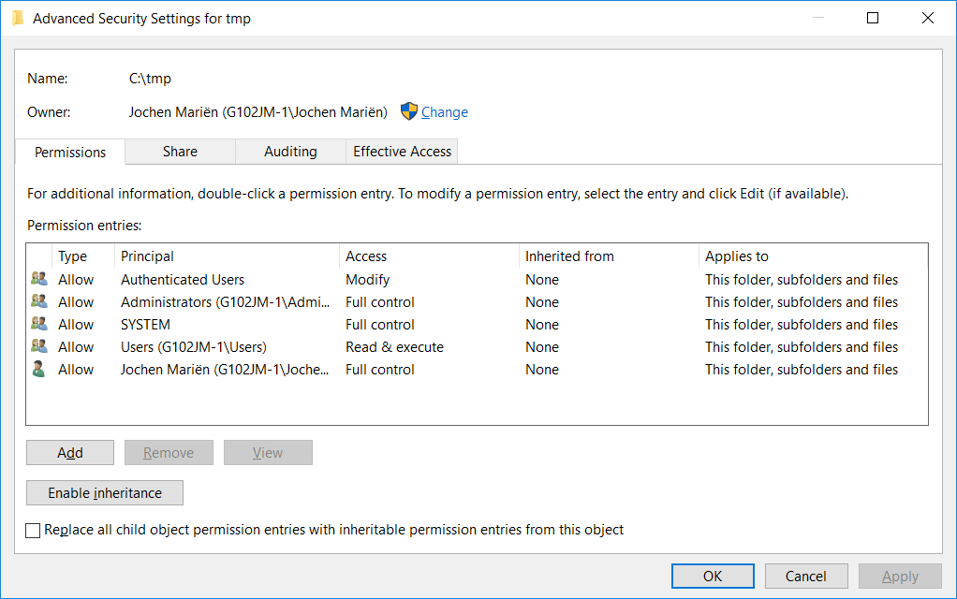
Security Descriptor - GUI

Slide 15
ACLs and ACEs
An ACL is an access control list
Contains who has which permission
An ACE is an access control entry
Defines one object and one permission
An ACL consists of one or more ACEs
We’ll be looking at ACEs for the file system
ACLs are also defined on the registry, AD, …
But with different permissions

Slide 16
ACEs (Access Control Entry)
Identity (trustee): Account
Access Control type: Allow / Deny
Access mask, defines the permissions of the trustee
Inheritance flags (... applies to ...)
ObjectInherit
ContainerInherit
None
Propagation flags (… taken from …)
InheritOnly
NoPropagateInherit
None

Slide 17
Accounts
Not necessarily (not preferably, even) users
Can be described in three ways
By account name: CD\Morgan.Freeman
By SID = Security Identifier: S-1-5-32-544
By SDDL sid (Security Descriptor Definition Language sid): BA
Well known SIDs:
https://msdn.microsoft.com/en-us/library/windows/desktop/aa379649(v=vs.85).aspx
SID string:
https://msdn.microsoft.com/en-us/library/windows/desktop/aa379602(v=vs.85).aspx

Slide 18
Accountnames or SIDs?
# Translate account name to SID
$account = New-Object system.Security.Principal.NTAccount("CD\Admin")
$SID = $account.translate([System.Security.Principal.SecurityIdentifier]).value
$SID
# Translate SID to account name
$account = New-Object system.Security.Principal.SecurityIdentifier($SID)
$name = $account.translate([System.Security.Principal.NTAccount]).value
$name

Slide 19
Well known SIDs?
[System.Enum]::getnames([System.Security.principal.WellknownSidType])
$SID = [System.Security.Principal.WellKnownSidType]::AuthenticatedUserSid
$account = New-Object system.Security.Principal.SecurityIdentifier($SID,$zero)
$name = $account.translate([System.Security.Principal.NTAccount]).value
$name
The example reads the SID for the Authenticated Users-group
…and uses that SID to get the name for that group.
Notes:
https://msdn.microsoft.com/en-us/library/system.security.principal.securityidentifier(v=vs.110).aspx

Slide 20
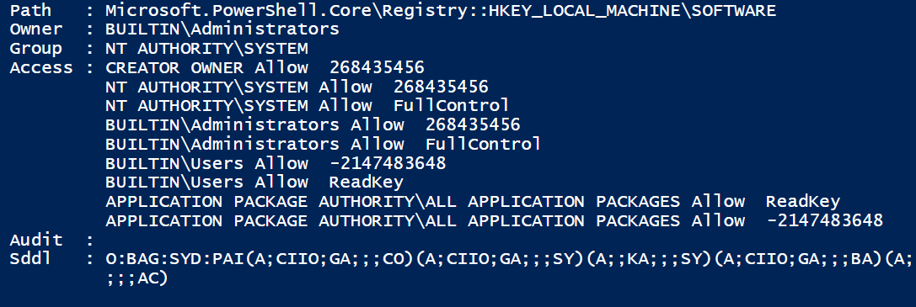
Reading a Security Descriptor
Get-Acl 'HKLM:\SOFTWARE' | Format-List
Get-Acl C:\tmp | Format-List
Owner
ACEs from DACL
ACEs from SACL
SDDL format

Slide 21
Reading an Access Control List (ACL)
We used “Get-ACL” to get the security descriptor
But the security descriptor consists mainly of the two ACLs we are interested in
Therefore, reading the ACL is equivalent to reading the security descriptor

Slide 22
Reading an Access Control Entry (ACE)
$a = Get-Acl 'c:\tmp'
$aces = $a.Access
#or
$aces = $a.GetAccessRules($true,$true,[System.Security.Principal.NTAccount])
We need the content of the “Access” property of an ACL
$a.Access
Or: use the function GetAccessRules()
Advantage: use the parameters to specify the format
Include the explicit permissions?
Include the inherited permissions?
Return account names or security identifiers?
Doesn’t return the SID!
Notes:
https://msdn.microsoft.com/en-us/library/system.security.accesscontrol.commonobjectsecurity.getaccessrules(v=vs.110).aspx

Slide 23
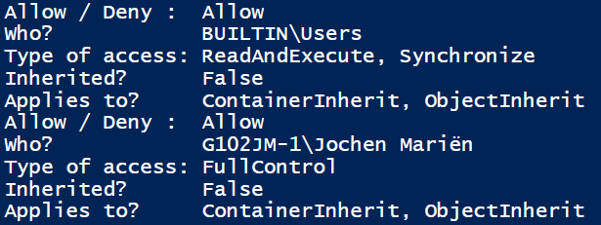
What is in the ACEs?
foreach ($ace in $aces)
{
"Allow / Deny : " + $ace.accesscontroltype
"Who? " + $ace.identityreference
"Type of access: " + $ace.filesystemrights
"Inherited? " + $ace.isinherited
"Applies to? " + $ace.inheritanceflags
}
…will result in:

Slide 24
Creating a new ACE
Enumerations
Contain useful lists of possible settings
Create the ACE
[System.Enum]::getnames([System.Security.AccessControl.FileSystemRights])
[System.Enum]::getnames([System.Security.AccessControl.AccessControlType])
[System.Enum]::getnames([System.Security.AccessControl.InheritanceFlags])
[System.Enum]::getnames([System.Security.AccessControl.PropagationFlags])
using namespace System.Security.AccessControl
$rights = [FileSystemRights]"ReadAndExecute"
$access = [AccessControlType]::Allow
$inherit = [InheritanceFlags]::ContainerInherit `
-bor [InheritanceFlags]::ObjectInherit
$propagation = [PropagationFlags]::InheritOnly
$accessrule = New-Object FileSystemAccessRule($user,$rights,$inherit,
$propagation,$access)
Notes:
“using namespace System…” only works from v5.0 and up
In earlier version, use the full name
$rights = [System.Security.AccessControl.FileSystemRights]"ReadAndExecute“ (etc.)

Slide 25
Creating a new ACE
Nowadays the reference to the AccessControl namespace is only needed when creating the Access rule object:
$accessrule = New-Object System.Security.AccessControl.FileSystemAccessRule("Everyone", "Read" “ContainerInherit", "ObjectInherit, InheritOnly", "Allow")
It is still a good idea to use references with long or difficult identities

Slide 26
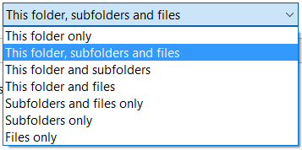
ACE inheritance
There are 7 possible settings for inheritance in the GUI:
They have to be set by using the InheritanceFlag and the PropagationFlag
But how do they translate?
[System.Security.AccessControl.InheritanceFlags]
[System.Security.AccessControl.PropagationFlags]

Slide 27
ACE inheritance
Permission | InheritanceFlags | PropagationFlags
This Folder only | None | None
Subfolders only | ContainerInherit | InheritOnly
Files only | ObjectInherit | InheritOnly
This folder, subfolders and files | ContainerInherit, ObjectInherit | None
This folder and subfolders | ContainerInherit | None
This folder and files | ObjectInherit | None
Subfolders and files | ContainerInherit, ObjectInherit | InheritOnly

Slide 28
Applying an ACE
We have the $accessrule (ACE) we made earlier
Then, read an ACL
Add the rule to that ACL
Save the ACL back to the folder
$acl = Get-Acl $dir
$acl.AddAccessRule($accessrule)
Set-Acl -AclObject $acl -Path $dir

Slide 29
Transfer an ACL
Get the ACL from the source folder
Set the ACL to the destination folder
Get-Acl C:\Source | Set-Acl c:\Destination

Slide 30
Remove an ACE from an ACL
All ACEs for one account
Get the ACL
PurgeAccessRules($account)
Set the ACL
Remove some ACEs
Get the ACL
RemoveAccessRule($ACE)
Set the ACL
What $ACE?
Go through the list
Recreate exactly
$acl = Get-Acl $dir
$account = New-Object
system.Security.Principal.NTAccount($user)
$acl.PurgeAccessRules($account)
Set-Acl -AclObject $acl -Path $dir
Notes:
$acl = Get-Acl $dir
# Acces to ACEs
$aces = $acl.Access
# Go through all ACEs
Foreach ($ace in $aces)
{
Write-Host $ace.IdentityReference.ToString() " has te permission to " $ace.FileSystemRights $ace.AccessControlType " Inherited? " $ace.IsInherited
# Selective removal
if ($ace.FileSystemRights.ToString() -match "ReadAndExecute")
{
"... is removed"
$result = $acl.RemoveAccessRule($ace)
}
}
# Save ACL
Set-Acl -AclObject $acl -Path $dir

Slide 31

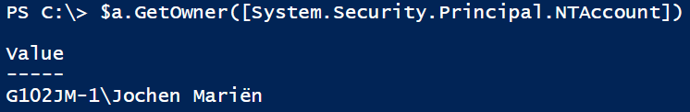
Owner
(Proves that Get-ACL gets the Security Descriptor, not the ACL)
$a = Get-Acl c:\tmp
$a.owner
$a.GetOwner([System.Security.Principal.NTAccount])
$a.GetOwner([System.Security.Principal.SecurityIdentifier])
Notes:
Security beperking van NTFS: you are only allowed to set the owner of a file to yourself or to the administrators group

Slide 32
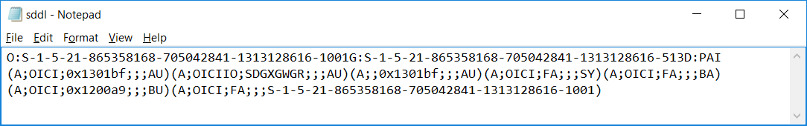
Working with SDDL
(Get-Acl "C:\tmp").sddl | out-file c:\tmp\sddl.txt
$sddl = Get-Content c:\test\sddl.txt
$acl = Get-Acl c:\destination
$acl.SetSecurityDescriptorSddlForm($sddl)
Set-Acl -AclObject $acl -path c:\destination
Why bother getting the ACL first? The SDDL contains the ACEs and owner, but not the inheritance…
Notes:
https://msdn.microsoft.com/en-us/library/system.security.accesscontrol.objectsecurity.setsecuritydescriptorsddlform(v=vs.110).aspx

Slide 33
On a lighter note…
[System.IO.Path]::GetRandomFileName()
[System.IO.Path]::GetTempFileName()
[System.IO.Path]::GetTempPath()

Slide 34


